Slide 1
EMPLOYEE ATTRITION ANALYSIS
K.SRI NISHAANTHI
DA|DS TRAINEE

Slide 2
PROJECT OVERVIEW
OBJECTIVE
Analyze employee attrition across various parameters
Make interactive dashboard
Report key insights and recommendations

Slide 3
DATA SET OVERVIEW
Employee attrition data set
Key attributes
Employee Demographics: Age, Gender, Marital Status, Over18
Job Information: JobRole, Department, Education, Education Field, Job Level
Compensation & Benefits: Monthly Income, Hourly Rate, Stock Option Level, Percent Salary Hike
Work Experience & Performance: Total Working Years, Years At Company, Years In CurrentRole
Satisfaction & Engagement: Environment Satisfaction, Job Satisfaction, Work Life Balance, Relationship Satisfaction
Work Conditions: Business Travel, Overtime, Distance From Home

Slide 4
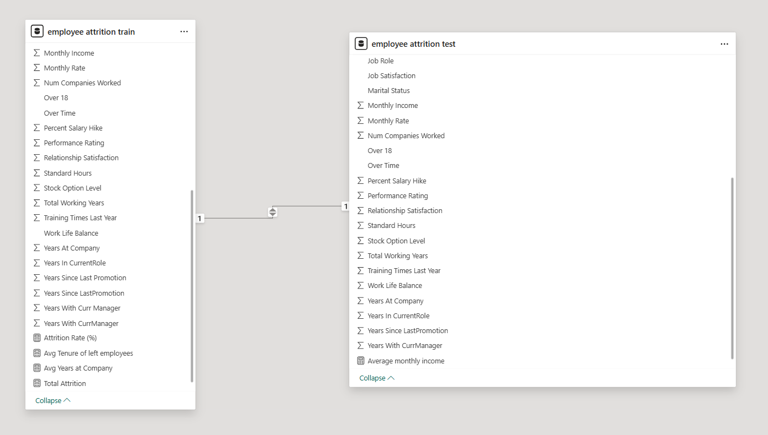
DATA CLEANING PROCESS
Power query
Handled missing values
Removed Duplicates
Standardized data types
Appended queries
Transformed and loaded dataset

Slide 5
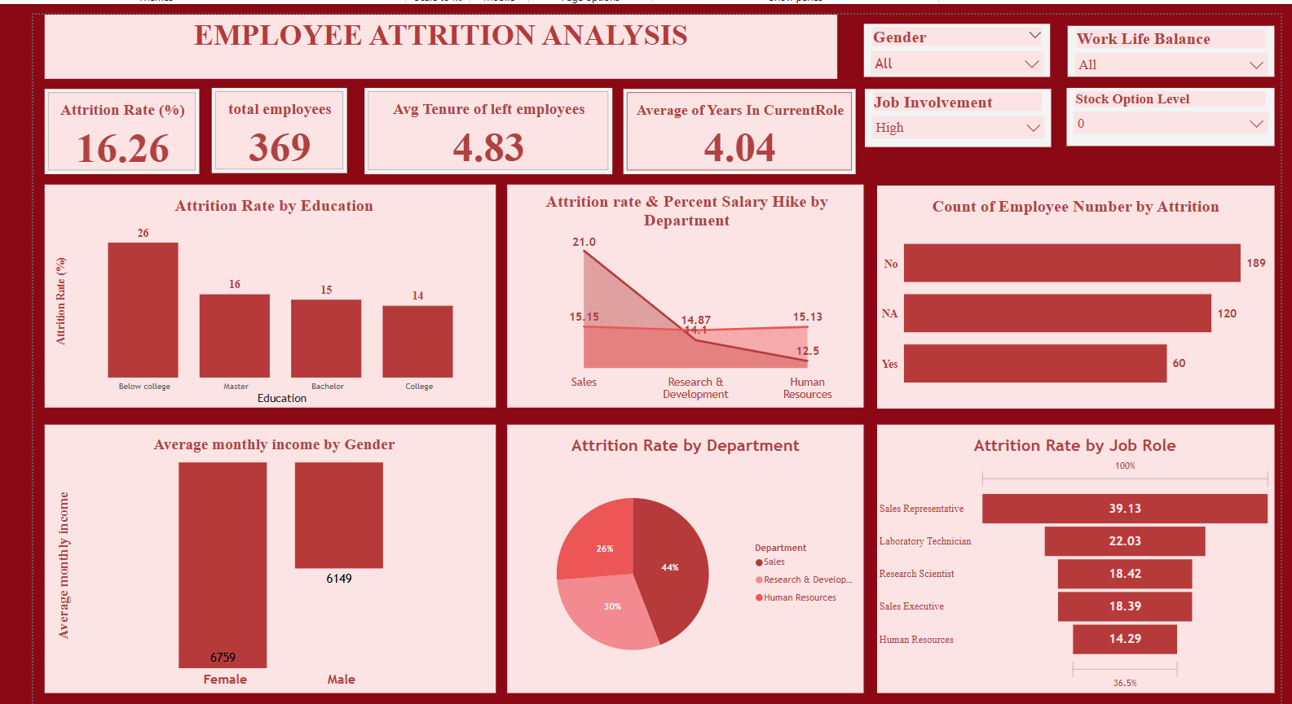
DASHBOARD

Slide 6
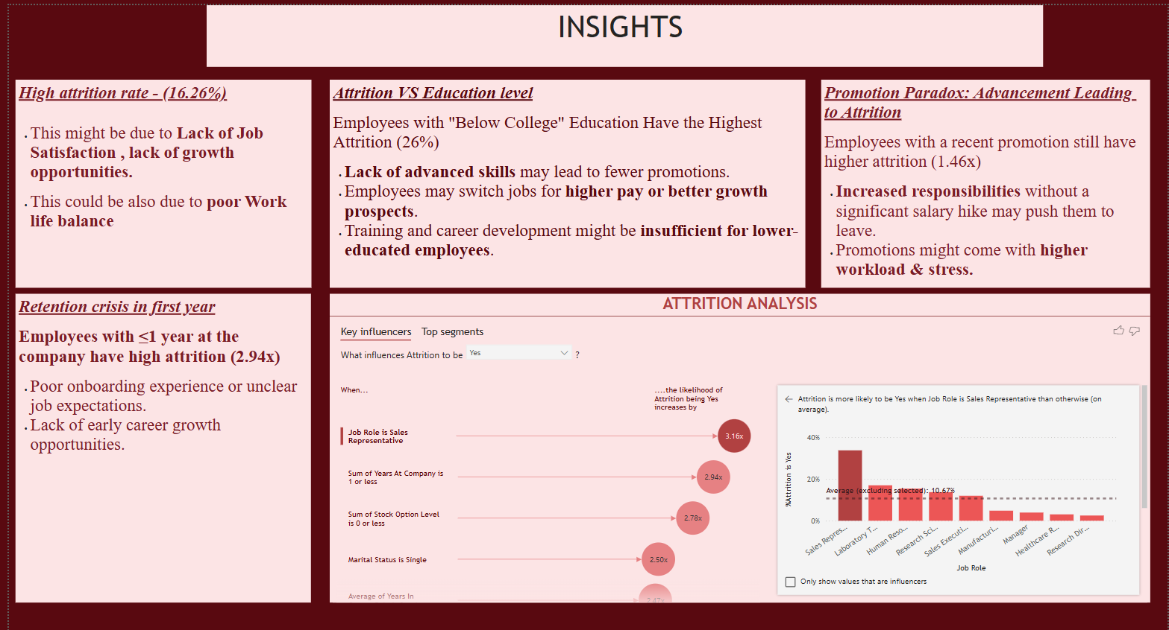
REPORT

Slide 7
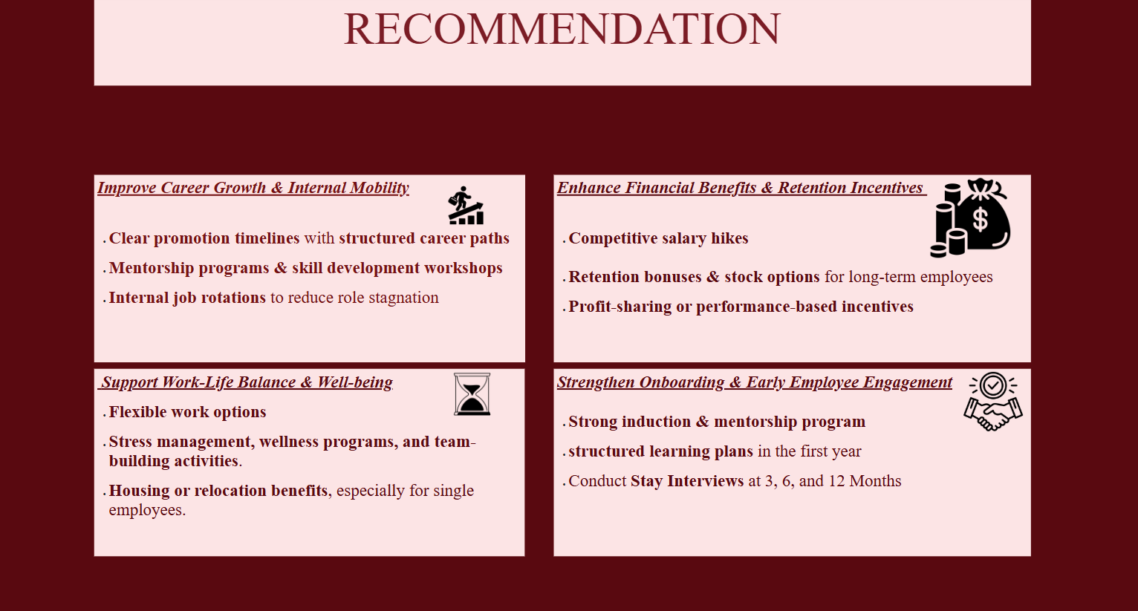

Slide 8
THANK YOU

